Slide 1
DUAL AXIS SOLAR SYSTEM WITH WEATHER SENSOR

Slide 2
TEAM MEMBERS
2110040071 R Rohan
2110040076 V Pavan kumar
2110040110 T Nithish
2110040112 Saketh
2110040115 K Sri Harsh

Slide 3
ABSTRACT
MARKET GAPSolar power is the fastest growing means of renewable energy. The project is designed and implemented using simple dual axis solar tracker system. In order to maximize energy generation from sun, it is necessary to introduce solar tracking systems into solar power systems. A dual-axis tracker can increase energy by tracking sun rays from switching solar panel in various directions. This solar panel can rotate in all directions. This dual axis solar tracker project can also be used to sense weather, and it will be displayed on LCD. This system is powered by Arduino, consists of servo motor, stepper motor, rain drop sensor, temperature and humidity sensor and LCD.

Slide 4
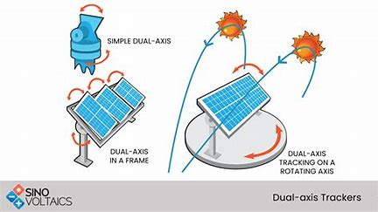

Slide 5
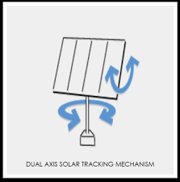
Why is it required
So, in order to accurately follow the sun, the two-axis tracking is required as solar azimuth angle as well as solar altitude angle of sun varies (in two axis) all the time . This optimizes maximum power from the PV system over a day than non-tracking system.

Slide 6
components
Atmega Microcontroller
Solar Panel
Servo Motor
DC Motor
Rain Sensor
Humidity Sensor
Temperature Sensor
Resistor
Capacitors
Transistors
Cables and Connectors
Diodes
PCB and Breadboards
LED
Transformer/Adapter
Push Buttons
Switch
IC
IC Sockets

Slide 7
SUMMARY
At Contoso, we believe in giving 110%. By using energy efficient building methods, we help commercial businesses grow and foster a consumer first mindset. We thrive because of our market knowledge and a great team behind our product. As our CEO says, "Efficiencies will come from proactively transforming how we do business."

Slide 8
USE OF WEATHER SENSOR
A weather sensor in a dual axis solar control panel is used to gather real-time environmental data such as temperature, wind speed, humidity, and precipitation. This information is used to adjust the position of the solar panels to optimize their performance and efficiency.
The weather sensor provides input to the control system of the solar panel, which uses algorithms to calculate the optimal angle and orientation of the solar panels based on the current weather conditions. For example, if the weather sensor detects that it is a cloudy day, the control system may adjust the angle of the solar panels to maximize their exposure to the available sunlight.
By incorporating a weather sensor into the control system of a dual axis solar panel, the panels can be automatically adjusted to ensure maximum energy production under all weather conditions. This can improve the overall efficiency of the solar panel system and maximize the return on investment for the owner.

Slide 9
THANK YOU
.

